Slide 1
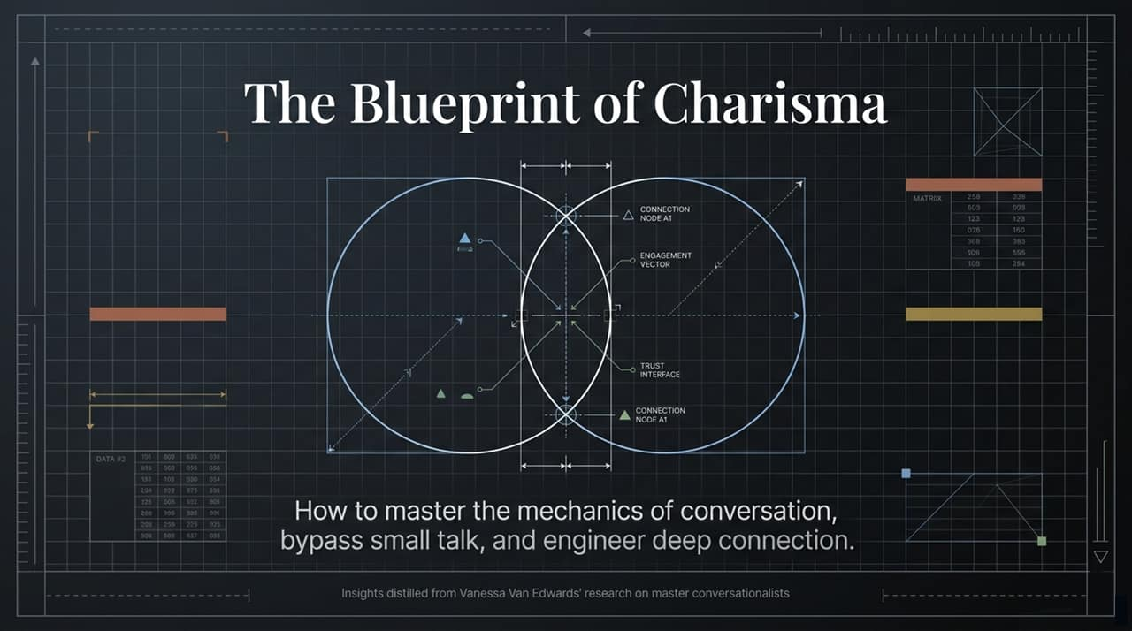
Notes:
Opening Hook: Welcome everyone. Today, we aren't just talking about "being nice" or making polite conversation. We are exploring the engineering and mechanics of connection.
Core Concept: Charisma is often viewed as a mysterious, innate quality—something you're either born with or not. But behavioral research, particularly the work of Vanessa Van Edwards, proves otherwise: charisma can be broken down into actionable patterns, non-verbal cues, and deliberate conversational structures.
Context & Purpose: Look at the diagram on the screen. Notice how connection nodes and engagement vectors intersect at a "Trust Interface." Over the next 15 slides, we will unpack how to transform everyday interactions from transactional autopilot into genuine magnetic connection. By the end of this session, you'll have a complete blueprint to master conversation mechanics and bypass superficial small talk.
https://www.youtube.com/watch?v=q2cg1gEYWJQ

Slide 2
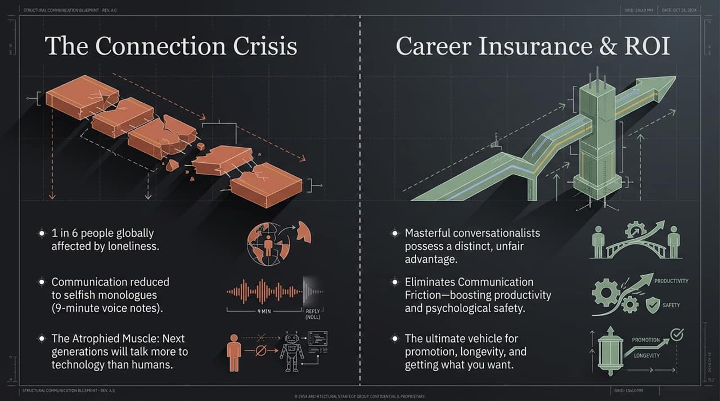
Notes:
The Problem: We are living through a modern social paradox. We are more digitally connected than at any point in human history, yet we are experiencing a global connection crisis.
Key Statistics & Observations:
Over 1 in 6 people worldwide report feeling severely affected by loneliness.
Modern communication is increasingly asynchronous and self-absorbed—exemplified by people sending 9-minute voice notes, which function more like selfish monologues than interactive dialogues.
The Core Risk: Communication is an atrophied muscle. As the upcoming generations converse more with AI models and smartphones than with real humans, our fundamental social skills deteriorate.
Key Takeaway for Presenter: Emphasize that conversation isn't just an extra optional skill—it is social health. If we don't actively practice real-time conversational reps, our ability to form trust and psychological safety will continue to decline.

Slide 3
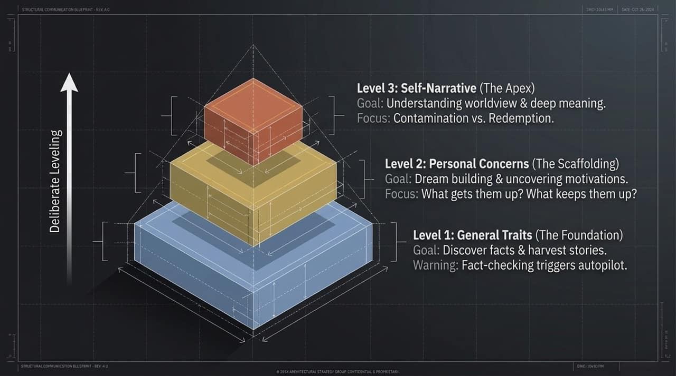
Notes:
Value Proposition: Why does mastering conversation matter in a professional setting? Because conversational intelligence is the ultimate unfair advantage and career insurance.
Friction Reduction: Master conversationalists don't just speak well; they eliminate communication friction. When friction disappears within a team, two things happen immediately:
Productivity skyrockets because messages are conveyed clearly without misunderstanding.
Psychological Safety increases, enabling team members to take creative risks and share honest feedback.
Career Trajectory: Whether you are pitching an idea, seeking a promotion, or building client trust, your social mechanics determine your ceiling. High competence combined with low warmth or poor delivery leads to overlooked talent. Mastering conversation is the engine for long-term career longevity and achieving your strategic goals.

Slide 4
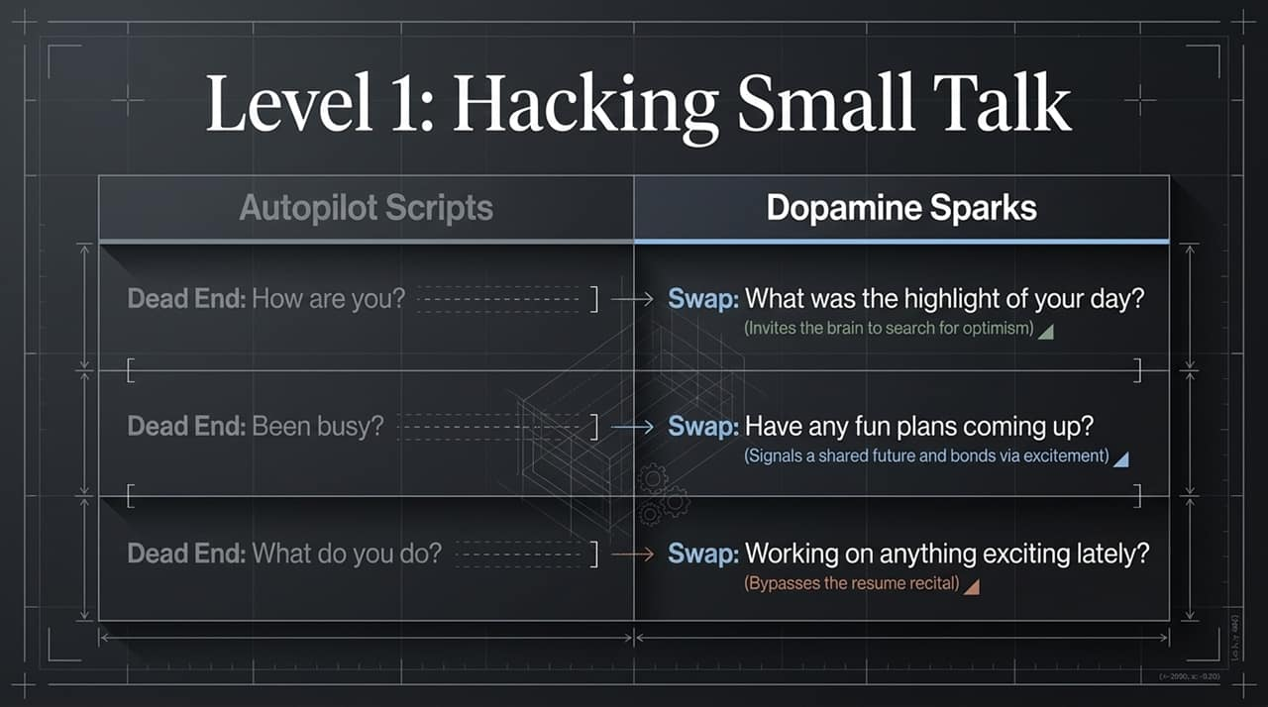
Notes:
Framework Overview: To move beyond surface-level chatter, we must understand the 3-Tier Model of Human Intimacy developed in psychological research.
Level 1: General Traits (The Foundation)
Goal: Gather basic facts and discover stories.
Warning: Asking autopilot, fact-checking questions ("Where do you work?", "How are you?") triggers administrative brain answers.
Level 2: Personal Concerns (The Scaffolding)
Goal: Uncover motivations, goals, and secret passions.
Focus: What gets them up in the morning? What keeps them up at night?
Level 3: Self-Narrative (The Apex)
Goal: Understand their core worldview, values, and deep identity.
Focus: Identifying whether they frame their life around a Redemption or Contamination narrative.
Takeaway: Your job as a conversational leader is to deliberately guide interactions from Level 1 up to Level 2 and Level 3 when appropriate.

Slide 5
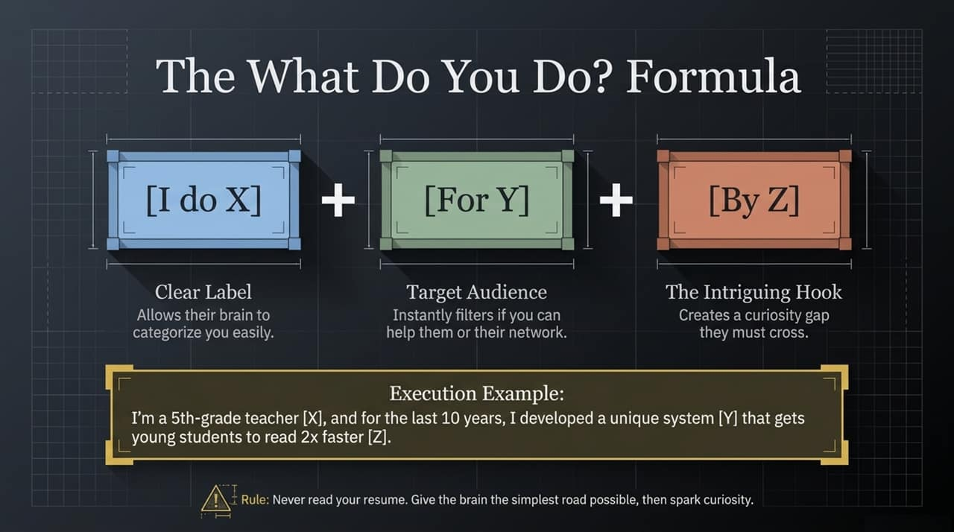
Notes:
Concept: Most small talk fails because it relies on "Autopilot Scripts". When you ask "How are you?", the brain responds automatically ("Good, you?") without engaging any real emotion or focus.
The Dopamine Spark Swaps:
Instead of "How are you?": Swap to "What was the highlight of your day?" This forces their brain to search for positive memories and optimism, releasing dopamine.
Instead of "Been busy?": Swap to "Have any fun plans coming up?" This signals a shared future and builds rapport through anticipation and excitement.
Instead of "What do you do?": Swap to "Working on anything exciting lately?" This gives them permission to discuss passion projects rather than reciting a boring job title.
Practice Tip: Challenge the audience to replace just one autopilot question during their next coffee break or networking session.

Slide 6
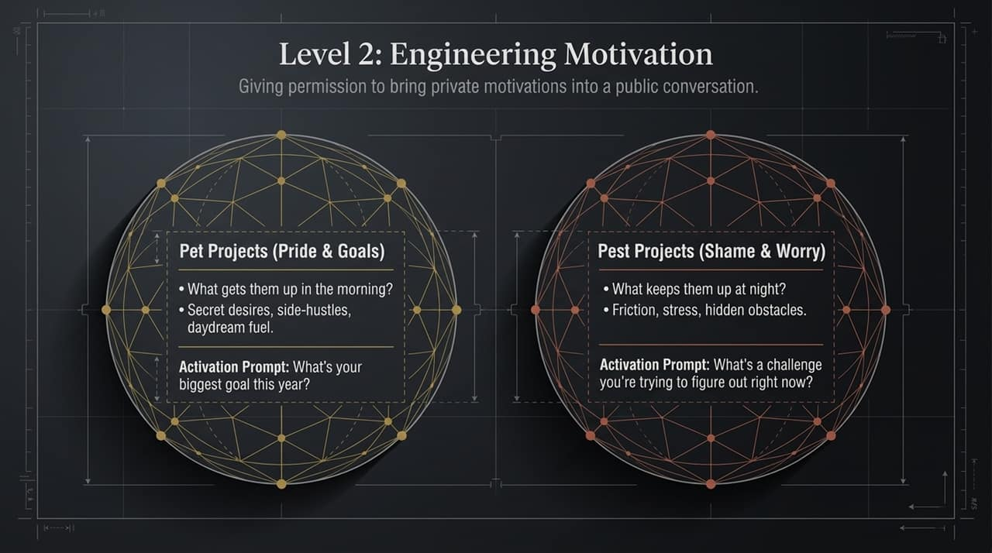
Notes:
Problem: When someone asks what you do, most people give a boring resume answer: "I'm a senior analyst at ACME Corp." This kills the conversation.
The Formula: Use the 3-part formula to create an engaging hook:
[X] Clear Label: Allows their brain to categorize your role effortlessly.
[Y] Target Audience: Identifies who you help, filtering whether they or their network connect with your work.
[Z] Intriguing Hook: Introduces a curiosity gap they feel compelled to ask about.
Example: "I'm a 5th-grade teacher [X], and for the last 10 years, I developed a unique system [Y] that gets young students to read 2x faster [Z]."
Rule: Never read your resume. Give the brain the simplest road possible, then spark immediate curiosity.

Slide 7
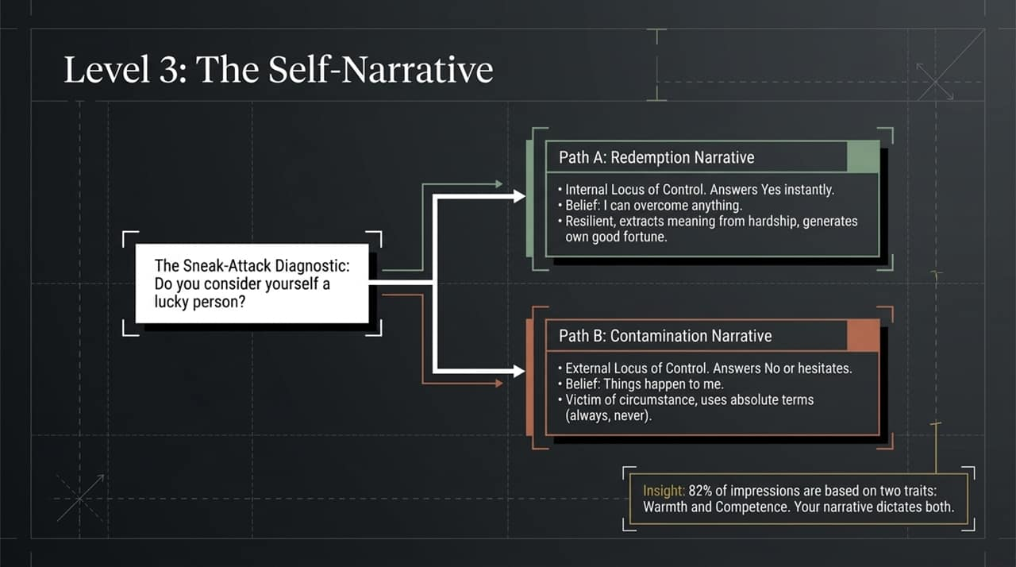
Notes:
Transitioning to Level 2: Once you bypass basic small talk, Level 2 is about understanding what drives the other person. You are giving them explicit permission to share private motivations in a public setting.
Pillar 1: Pet Projects (Pride & Goals)
These are side projects, secret desires, or personal ambitions.
Activation Prompt: "What's your biggest goal this year?" or "What's a project you're secretly excited about?"
Pillar 2: Pest Projects (Shame & Worry)
These are friction points, stressors, or obstacles keeping them awake at night.
Activation Prompt: "What's a challenge you're trying to figure out right now?"
Key Insight: People love talking about what they are trying to solve or build. Asking about Pet and Pest projects positions you as a trusted collaborator, not just a casual observer.

Slide 8
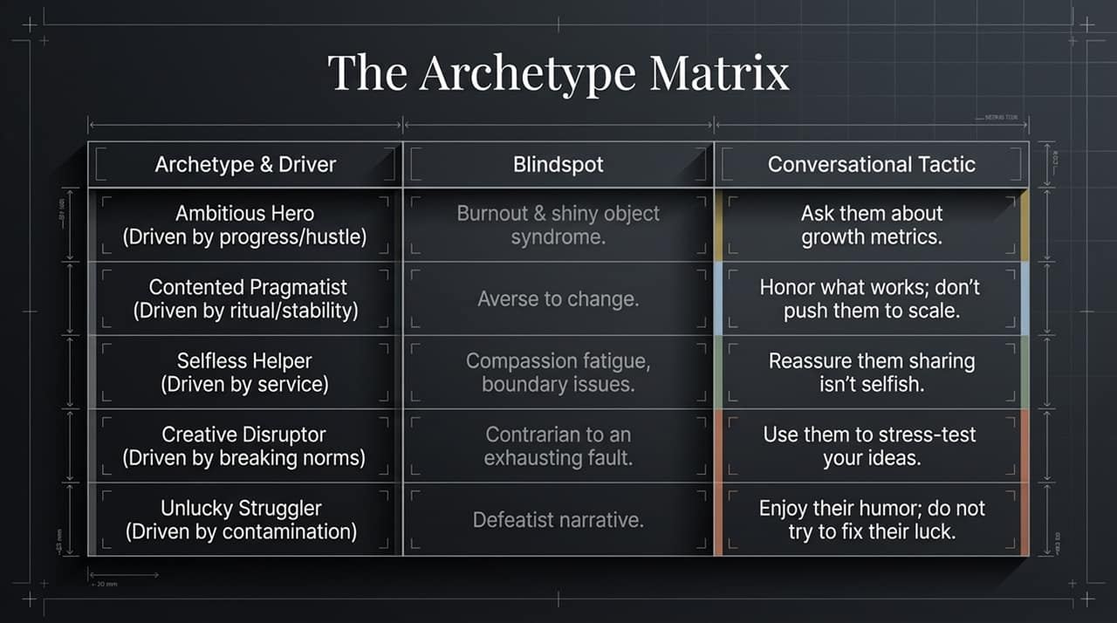
Notes:
The Apex Level: At Level 3, you are uncovering the fundamental story a person tells themselves about who they are.
The Sneak-Attack Diagnostic: Ask the simple question: "Do you consider yourself a lucky person?"
Path A: Redemption Narrative
Trait: Internal Locus of Control. They immediately answer "Yes."
Belief: "I can overcome adversity." They frame past hardships as lessons that led to growth. They generate their own luck.
Path B: Contamination Narrative
Trait: External Locus of Control. They answer "No" or hesitate.
Belief: "Bad things always happen to me." They frame good events as ruined by inevitable bad outcomes. They frequently use absolute terms like "always" or "never."
Core Insight: Research shows 82% of first impressions are built on Warmth and Competence. Which narrative a person lives in directly dictates how warm and competent they appear.

Slide 9
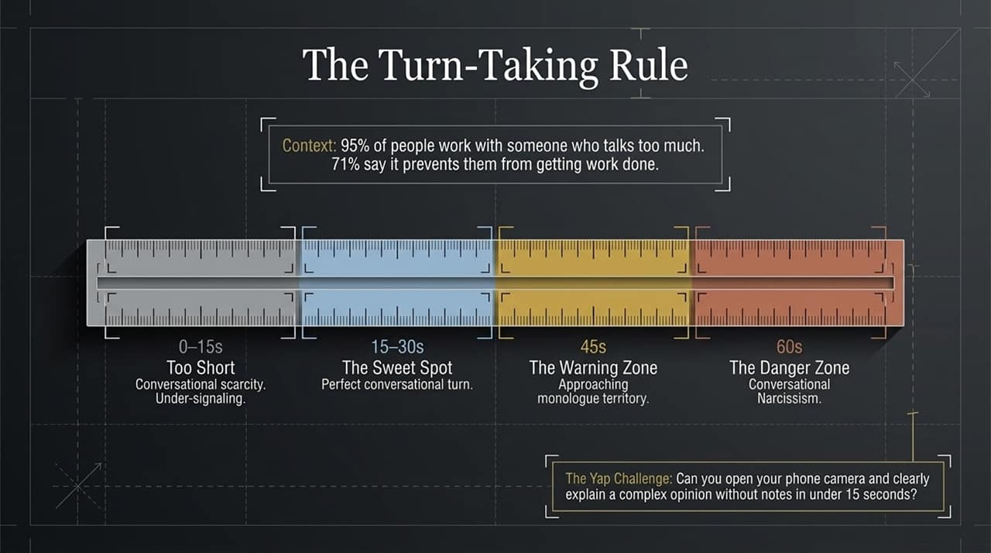
Notes:
Navigating Personalities: When engaging with people at Level 2 and 3, you will encounter distinct archetypes. Adapt your conversational approach based on their driver:
Ambitious Hero (Driven by progress): Watch for burnout. Tactic: Ask them about growth metrics and big milestones.
Contented Pragmatist (Driven by stability): Averse to sudden change. Tactic: Ask what currently works; don't force them to scale prematurely.
Selfless Helper (Driven by service): Prone to compassion fatigue. Tactic: Reassure them that sharing their own needs isn't selfish.
Creative Disruptor (Driven by breaking norms): Can be contrarian to a fault. Tactic: Enlist them to stress-test your ideas.
Unlucky Struggler (Driven by contamination): Defeatist mindset. Tactic: Enjoy their dark humor; do not try to fix their luck.

Slide 10
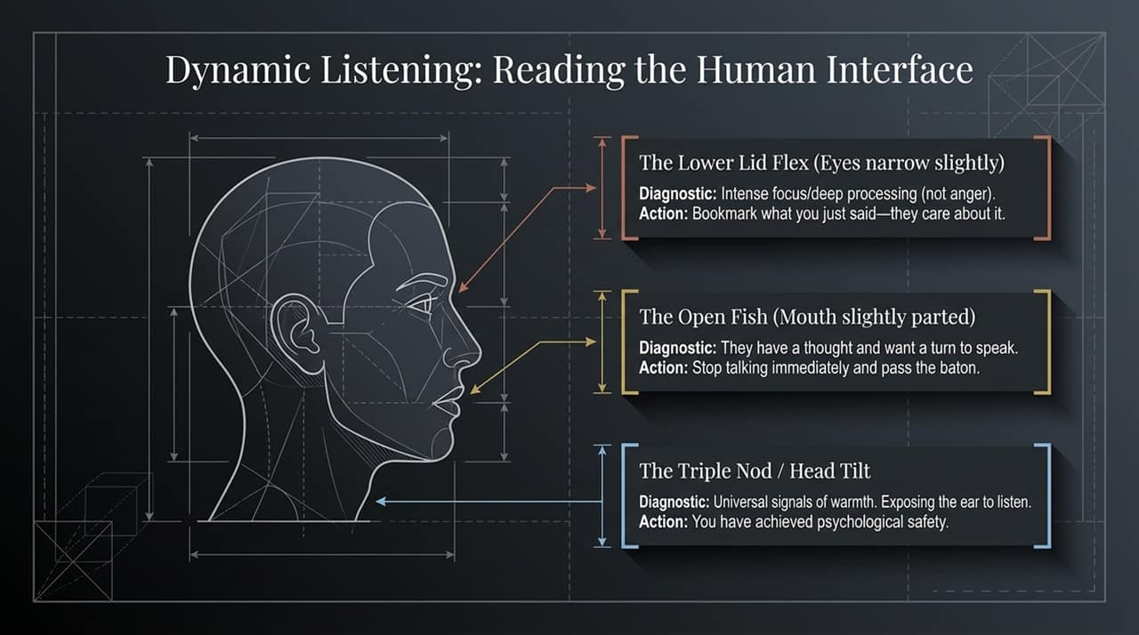
Notes:
Workplace Context: 95% of professionals report working with someone who talks too much, and 71% say over-talking directly hinders their productivity.
The Turn-Taking Timeline:
0–15 Seconds (Too Short): Creates conversational scarcity and under-signaling.
15–30 Seconds (The Sweet Spot): The ideal conversational turn. It gives enough detail to add value without losing the listener's attention.
45 Seconds (Warning Zone): You are approaching monologue territory. Look for disengagement signals.
60+ Seconds (The Danger Zone): Conversational Narcissism. You have taken hostage of the conversation.
The Yap Challenge: Try opening your camera right now and explaining a complex opinion without notes in under 15 seconds. It forces conciseness and clarity.

Slide 11
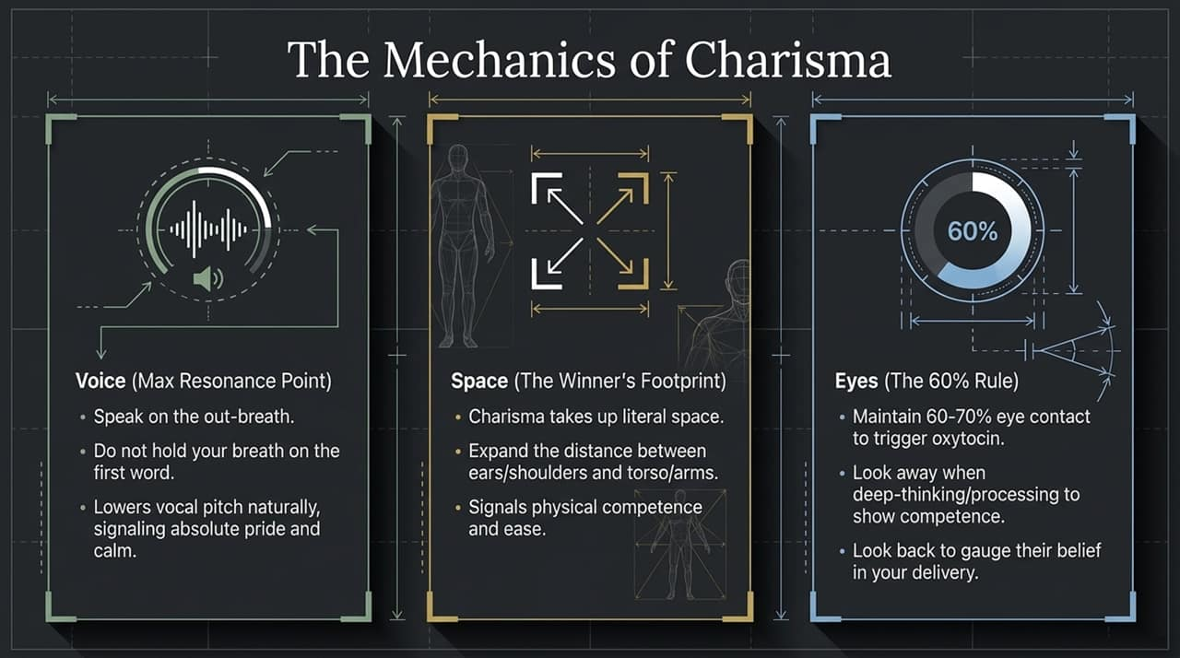
Notes:
Listening Beyond Words: High-charisma individuals constantly monitor the non-verbal cues of their listener to adjust real-time pacing.
1. The Lower Lid Flex (Eyes narrow slightly):
Diagnostic: This is NOT anger; it indicates intense focus and cognitive processing.
Action: Bookmark the topic you just mentioned—they care deeply about it.
2. The Open Fish (Mouth slightly parted):
Diagnostic: The person has a thought and is waiting for an opening to speak.
Action: Stop speaking immediately and pass the conversational baton.
3. The Triple Nod / Head Tilt:
Diagnostic: Universal warmth indicators exposing the ear to listen actively.
Action: You have achieved psychological safety; keep going.

Slide 12
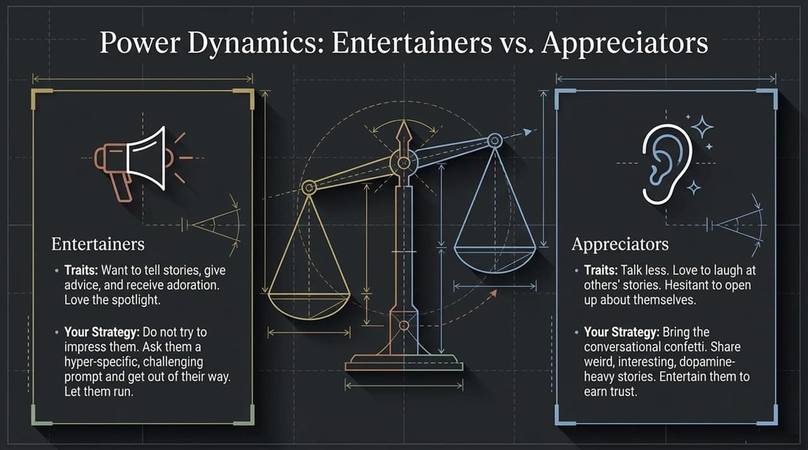
Notes:
Physical Dynamics: Charisma is deeply embodied. There are three specific physiological mechanics you can control:
Voice (Max Resonance Point):
Always speak on the out-breath. Avoid holding your breath on your opening word, which causes high-pitched vocal strain. Speaking on an exhale naturally lowers vocal pitch, signaling calm authority and pride.
Space (The Winner's Footprint):
Charisma occupies physical real estate. Expand the distance between your ears/shoulders and keep your torso uncrossed. This signals physical confidence and ease.
Eyes (The 60% Rule):
Aim for 60–70% eye contact to trigger oxytocin release. Look away briefly when processing complex thoughts to demonstrate high competence, then re-engage eye contact to deliver key points.

Slide 13
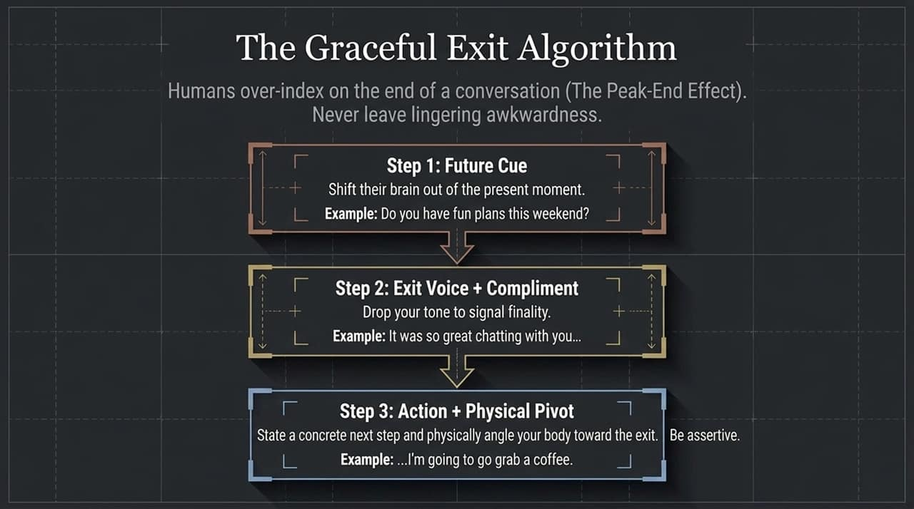
Notes:
Social Archetypes in Groups: Every room contains two main conversational profiles: Entertainers and Appreciators.
Entertainers:
Traits: Love the spotlight, tell stories, give advice, and seek validation/adoration.
Strategy: Do not try to out-shine or compete with them. Ask them a hyper-specific, challenging prompt and let them run with the conversation.
Appreciators:
Traits: Prefer to listen, laugh at others' jokes, but are hesitant to open up about themselves.
Strategy: Bring the conversational energy to them. Share engaging, dopamine-rich stories to make them feel comfortable, earning their trust until they open up.

Slide 14
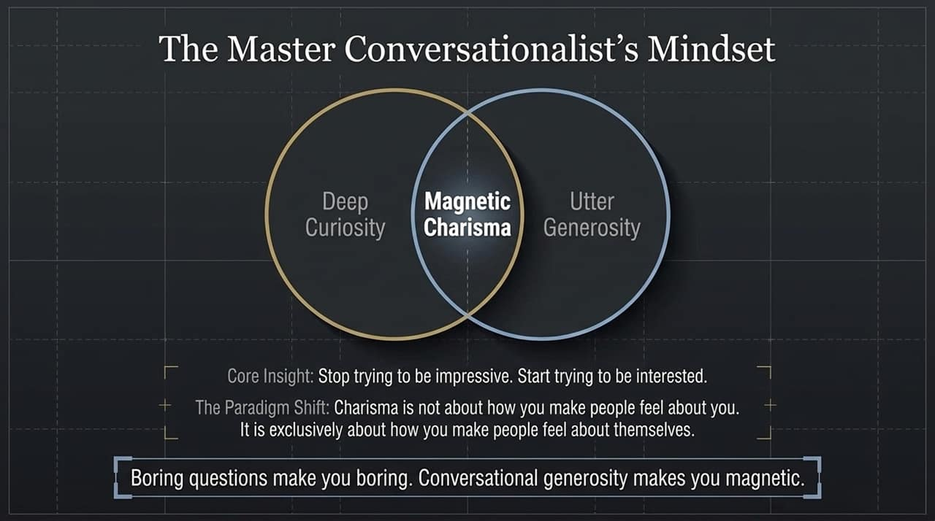
Notes:
Psychological Principle: Due to the Peak-End Effect, people judge an interaction primarily by how it ended. Ending awkwardly ruins an otherwise great conversation.
Step 1: Future Cue
Shift their focus to upcoming events. Example: "Do you have fun plans for this weekend?"
Step 2: Exit Voice + Compliment
Drop your vocal pitch downward to signal finality. Example: "It was so great chatting with you..."
Step 3: Action + Physical Pivot
State a clear, assertive reason to leave and physically pivot your shoulders away. Example: "...I'm going to grab a fresh drink/head to my next meeting."

Slide 15
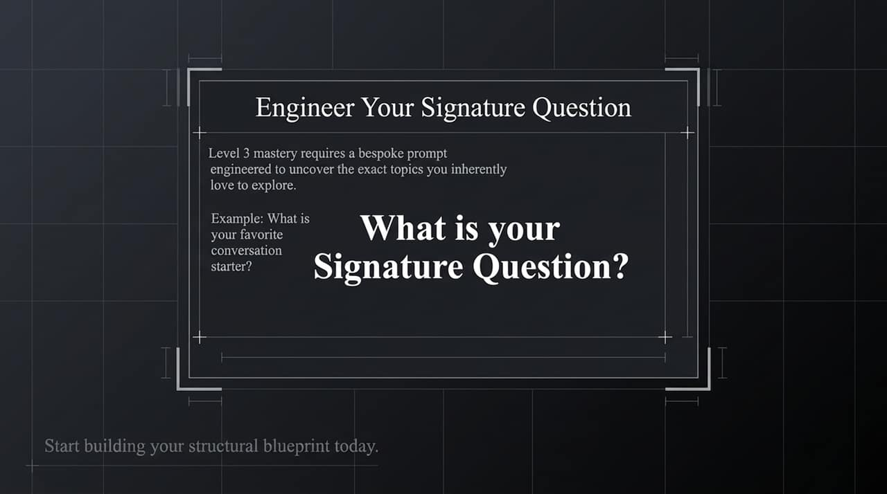
Notes:
Core Paradigm Shift: Stop trying to be impressive; start focusing on being interested.
Definition of Magnetic Charisma: Charisma is not about how you make people feel about you. It is exclusively about how you make people feel about themselves in your presence.
Closing Thought: Boring questions yield boring, autopilot responses. Conversational generosity—asking insightful questions, actively listening, and holding space—is what makes an individual unforgettable.
Call to Action: As we wrap up this core section, ask yourself: What is your signature question going to be? How will you structure your next conversation to build immediate trust?

Slide 16
